Slide 1
Models of matter
Ideal gas
No interaction b/w individual constituents
Quantum version → explain black body radiation, electrical conduction in simple metals.
low-temperature heat capacity of solids
Issues: How does the system reach to equilibrium, if no interaction?
Inter particle potential
Lennard-Jones potential
Simple interactions: U(r) → ∞ for r ≤ δ and →0 for r ≥ δ
Lattice
Particles are fixed in space
→ momenta of particles become irrelevant
Simplest: Ising model
Magnetic moments or Spins fixed on lattice (±1)
Dilute gases
Dense gas and liquids
If particles are independent oscillators
=> Einstein model
Simple explanation of transition b/w Ferromagnetic and Paramagnetic states

Slide 2
Physical characteristics of matter
Density (or mass or volume)
Pressure
Temperature

Slide 3
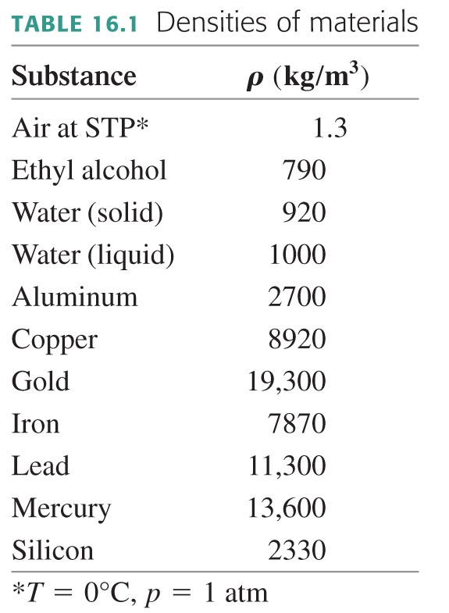
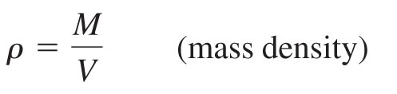
Density
Mass density = the ratio of a system’s mass to its volume
SI units: kg/m³

Slide 4
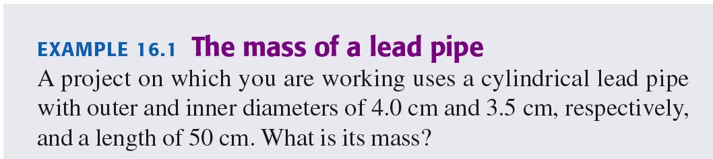

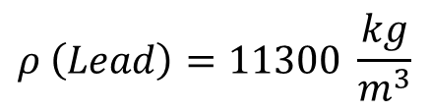




EXAMPLE: The mass of a lead pipe
$$ρ \left(Lead\right)=11300 \frac{kg}{m^{3}}$$
$$ρ=\frac{m}{V}$$
$$V=πr^{2}ℓ$$
$$V=πℓ[({\frac{4}{2})}^{2}−({\frac{3.5}{2})}^{2}]$$
$$147.3 {cm}^{3}$$
$$m=1.66 kg$$

Slide 5
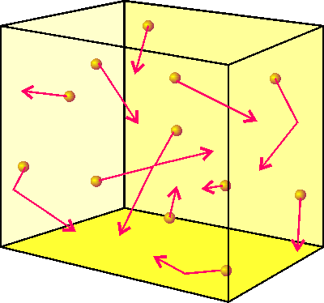
Model of a many-particle system: the Ideal Gas
Models of matter: gas models (random motion of particles)
lattice models (positions of particles are fixed)
Air at normal conditions:
~ 2.7 × 10¹⁹ molecules in 1 cm³ of air (Pr. 1.10)
Size of the molecules ~ (2-3) × 10⁻¹⁰ m, distance between the molecules ~ 3 × 10⁻⁹ m
The average speed - 500 m/s
The mean free path - 10⁻⁷ m (0.1 micron)
The number of collisions in 1 second - 5 × 10⁹
The ideal gas model - works well at low densities (diluted gases)
all the molecules are identical, N is huge;
the molecules are tiny compared to their average separation (point masses);
the molecules do not interact with each other;
the molecules obey Newton’s laws of motion, their motion is random;
collisions between the molecules and the container walls are elastic.
The quantum version of the ideal gas model helps to understand the blackbody radiation, electrons in metals, the low-temperature behavior of crystalline solids, etc.

Slide 6
The Equation of State of Ideal Gases
An equation of state - an equation that relates macroscopic variables (e.g., P, V, and T) for a given substance in thermodynamic equilibrium.
In equilibrium (≡ no macroscopic motion), just a few macroscopic parameters are required to describe the state of a system.
Geometrical representation of the equation of state:
P
an equilibrium
state
the equation-
of-state surface
f (P,V,T) = 0
V
T
The ideal gas equation of state:
P – pressure [Newtons/m²]
V – volume [m³]
n – number of moles of gas
T – the temperature in Kelvins [K]
R – a universal constant

Slide 7
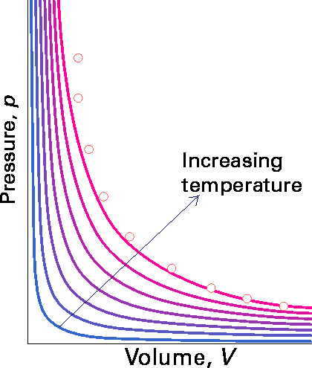
The Ideal Gas Law
In terms of the total number of molecules, N = n⋅N_{A}
Avogadro’s number
N_{A} ≈ 6.022045 × 10²³
the Boltzmann constant k_{B} = R/N_{A} ≈ 1.38 × 10⁻²³ J/K
(introduced by Planck in 1899)
The equations of state cannot be derived within the frame of thermodynamics: they can be either considered as experimental observations, or “borrowed” from statistical mechanics.
isotherms
Avogadro’s Law: equal volumes of different gases at the same P and T contain the same amount of molecules.
The P-V diagram – the projection of the surface of the equation of state onto the P-V plane.

Slide 8
The van der Waals model of real gases
For real gases – both quantitative and qualitative deviations from the ideal gas model
U(r)
Electric interactions between
electro-neutral molecules :
r
van der Waals
attraction
repulsion
attraction
The van der Waals equation of state for real gases
Notes:
Second part of first term is due to the fact that a gas cannot be compressed down to zero volume; the second part of the second term arises from the attractive/repulsive forces that arise between molecules.

Slide 9
Connection between K_{tr} and T for Ideal Gases
?
T of an ideal gas ⇔ the kinetic energy of molecules
Pressure – the result of collisions between the molecules and walls of the container.
Momentum
Strategy: Pressure = Force/Area = [Δp / Δt ]/Area
For each (elastic) collision: Δp_{x} = 2 m v_{x}
Intervals between collisions: Δt = 2 L/v_{x}
Piston area A
v_{x}
Volume = LA
L
For N molecules -
no-relativistic
motion

Slide 10
Connection between K_{tr} and T for Ideal Gases (cont.)
Average kinetic energy of the translational motion of molecules:
the temperature of a gas is a direct measure of the
average translational kinetic energy of its molecules!
The internal energy U of a monatomic ideal gas is independent of its volume and depends only on T (ΔU = 0 for an isothermal process, T = const).
for an ideal gas of non-relativistic particles,
kin. energy ∝ (velocity)² .

Slide 11
Units for Energy, Temperature
the kinetic energy is proportional to the temperature, and the Boltzmann constant k_{B} is the coefficient of proportionality that provides one-to-one correspondence between the units of energy and temperature.
If the temperature is measured in Kelvin, and the energy in Joules:
k_{B} = 1.38 × 10⁻²³ J/K
In many sub-fields of physics that deal with microscopic particles (including condensed matter physics, physics of high energies, astrophysics, etc.), a convenient unit for energy is an electron-Volt (the kinetic energy acquired by an electron accelerated by the electrostatic potential difference in 1 V).
1 eV = 1.6 × 10⁻¹⁹ J
k_{B} = 8.62x10⁻⁵ ev/K
At T = 300K

Slide 12
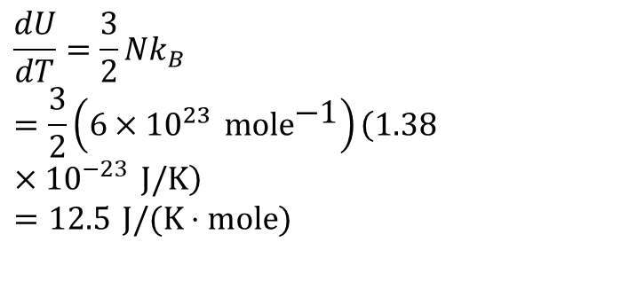
Comparison with Experiment
 | dU/dT (300K) (J/K·mole)
Monatomic
Helium | 12.5
Argon | 12.5
Neon | 12.7
Krypton | 12.3
Diatomic
H₂ | 20.4
N₂ | 20.8
O₂ | 21.1
CO | 21
Polyatomic
H₂O | 27.0
CO₂ | 28.5
for a point mass with three degrees of freedom
Testable prediction: if we put a known dU into a sample of gas, and measure the resulting change dT, we expect to get
$$\frac{dU}{dT}=\frac{3}{2}Nk_{B} \\ =\frac{3}{2}\left(6×10^{23} \text{mol}{\text{e}}^{\text{−1}}\right)\left(1.38×10^{−23} \text{J}\text{/}\text{K}\right) \\ =12.5 \text{J}\text{/(}\text{K}⋅\text{mole}\text{)}$$
Conclusion: diatomic and polyatomic gases can store thermal energy in forms other than the translational kinetic energy of the molecules.
Notes:
The use of temperature as a measure of internal energy is accurate for monatomic gases [(3/2)RT], but not so for diatomic and polyatomic gases. Why? Because diatomic and polyatomic gases can store energy in areas other than their translational energy. This leads us to the equipartition theorem and degrees of freedom.

Slide 13
Degrees of Freedom
Indeed, polyatomic molecules have more than just three degrees of freedom – they rotate and vibrate.
The degrees of freedom of a system are a collection of independent variables required to characterize the system.
Thus, for instance, the degrees of freedom of an ideal gas, in a thermodynamic description, are P and V (or a pair of other variables).
The independent coordinates that describe the position of a mechanical system in space - e.g., for a rigid body, it is sufficient to specify the coordinates of its center of mass (x, y, z) and three angles (ϕ_{x}, ϕ_{y}, ϕ_{z}).
I_{x} – the moment of inertia for rotations around the x-axis, etc.
Polyatomic molecules: 6 trans. and rot. degrees of freedom
Diatomic molecules: 3 + 2 = 5 trans. and rotational degrees of freedom (QM: degrees of freedom corresponding to rotations that leave the molecule completely unchanged do not count )

Slide 14
Degrees of Freedom (cont.)
Plus all vibrational degrees of freedom. The one-dimensional vibrational motion counts as two degrees of freedom (kin. + pot. energies):
For a diatomic molecule (e.g., H₂), 5 trans. and rotational degrees of freedom plus 2 vibrational degrees of freedom = total 7 degrees of freedom
Among 7 degrees of freedom, only 3 (translational) degrees correspond to a continuous energy spectrum, the other 5 to a discrete energy spectrum.
U(x)
U(x)
E₄
E₃
E₂
E₁
x
x

Slide 15
Equipartition of Energy
“Quadratic” degree of freedom – the corresponding energy = f(x², v_{x}²)
[ translational motion, (classical) rotational and vibrational motion, etc. ]
Equipartition Theorem: At temperature T, the average energy of any “quadratic” degree of freedom is 1/2k_{B}T.
holds only for a system of particles whose kinetic energy is a quadratic form of x², v_{x}² (e.g., the equipartition theorem does not work for photons, E = cp)
Piston – a mechanical system with one degree of freedom. Thus,
v_{x}
M is the mass of a piston, ⟨u²⟩ the average u², where u is the piston’s speed along the x-axis.
Thus, the energy that corresponds to the one-dimensional translational motion of a macroscopic system is the same as for a molecule (in this respect, a macrosystem behaves as a giant “molecule”).

Slide 16
Equipartition of Energy (alternative)
Equipartition Theorem: Every kind of molecule has a certain number f of degrees of freedom, which are independent ways in which the molecule can store energy. Each such degree of freedom has associated with it, on average, an energy of ½ kT per molecule (or ½ RT per mole).

Slide 17
“Frozen” degrees of freedom
U /k_{B}T
one mole of H₂
7/2N
Vibration
5/2N
For an ideal gas
PV = Nk_{B}T
U = (f/2) Nk_{B}T
Rotation
3/2N
Translation
10
100
1000
T, K
Example of H₂:
An energy available to a H₂ molecule colliding with a wall at T = 300 K: (3/2)k_{B}T ~ 40 meV. If the difference between energy levels is >> k_{B}T, then a typical collision cannot cause transitions to the higher (excited) states and thus cannot transfer energy to this degree of freedom: it is “frozen out”.
U(x)
E₄
E₃
k_{B}T
E₂
E₁
x
The rotational energy levels are ~15 meV apart, the difference between vibrational energy levels ~270 meV. Thus, the rotational degrees start contributing to U at T > 100 K, the vibrational degrees of freedom at T > 1000 K.

Slide 18
Internal Energy
The internal energy of a system of particles, U, is the sum of the kinetic energy in the reference frame in which the center of mass is at rest and the potential energy arising from the forces of the particles on each other.
system
boundary
system
U = kinetic + potential
“environment”
B
The internal energy is a state function – it depends only on the values of macroparameters (the state of a system), not on the method of preparation of this state (the “path” in the macroparameter space is irrelevant).
P
T
V
A
In equilibrium [ f (P, V, T) = 0 ] :
U = U (V, T)
U depends on the kinetic energy of particles in a system and an average inter-particle distance (~ 1/V^{1/3}) – interactions.
For an ideal gas (no interactions) : U = U (T) “pure” kinetic

Slide 19
Internal Energy of an Ideal Gas
The internal energy of an ideal gas
with f degrees of freedom:
f ⇒ 3 (monatomic), 5 (diatomic), 6 (polyatomic)
(here only translational and rotational degrees of freedom are considered; neglect the vibrational that can be excited at very high temperatures)
How does the internal energy of air in this (not-air-tight) room change with T if the external P = const?
It does not change at all; an increase in the kinetic energy of individual molecules with T is compensated by a decrease of their number.

Slide 20
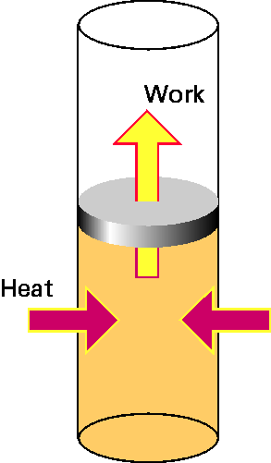
Work and Heating (“Heat”)
WORK
We are often interested in ΔU , not U; ΔU is due to:
Q – energy flow between a system and its environment due to ΔT across a boundary and a finite thermal conductivity of the boundary
– heating (Q > 0) or cooling (Q < 0)
(there is no such physical quantity as “heat”; to emphasize this fact, it is better to use the term “heating” rather than “heat”)
W – any other kind of energy transfer across boundary
HEATING
Work and Heating are both defined to describe energy transfer across a system boundary.
Heating/cooling processes:
Conduction:
the energy transfer by molecular contact – fast-moving molecules transfer energy to slow-moving molecules by collisions;
Convection:
by macroscopic motion of gas or liquid
Radiation:
by emission/absorption of electromagnetic radiation.

Slide 21
The First Law of Thermodynamics
The first law of thermodynamics: the internal energy of a system can be changed by doing work on it or by heating/cooling it.
ΔU = Q + W
From the microscopic point of view, this statement is equivalent to
a statement of conservation of energy.
Sign convention: we consider Q and W to be positive if energy flows into the system.
P
For a cyclic process (U_{i} = U_{f}) ⇒ Q = – W.
If, in addition, Q = 0 then W = 0
T
V
An equivalent formulation:
Perpetual motion machines of the first type do not exist.
Perpetual motion machines come in two types:
Type 1 violates the 1st Law (energy would be created from nothing),
Type 2 violates the 2nd Law (the energy is extracted from a reservoir in a way that causes the net entropy of the machine and reservoir to decrease).

Slide 22
Assignment#1
Problems for Friday
1.1, 1.2, 1.3, 1.9, 1.10, 1.12 and 1.14
Problems: 1.18, 1.19, 1.20, 1.21 & 1.25
Due: Friday Jan 28th

